Slide 1
Final Project On-board FIFO Results
ECE 6213
Osama Yousuf, Joseph Riem

Slide 2
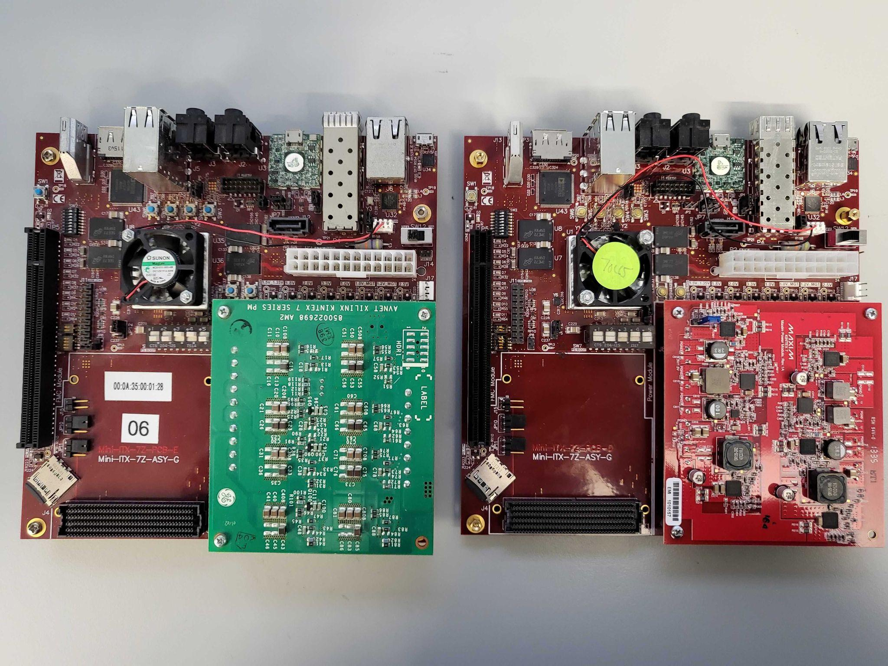
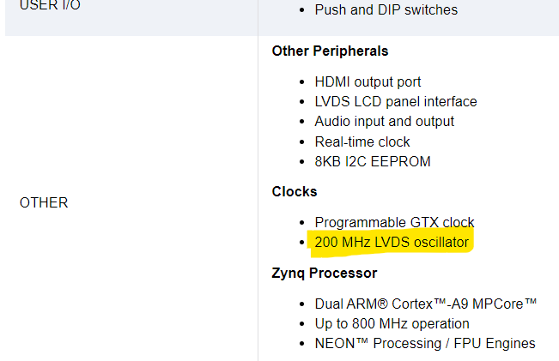
Clock Source
We have a 200 MHz differential clock source on the Mini ITX Boards
Mini-ITX Boards in ADAM Lab @ GW
Hard processor (PS) + FPGA Fabric (PL)
Source: https://www.avnet.com/wps/portal/us/products/avnet-boards/avnet-board-families/mini-itx/

Slide 3
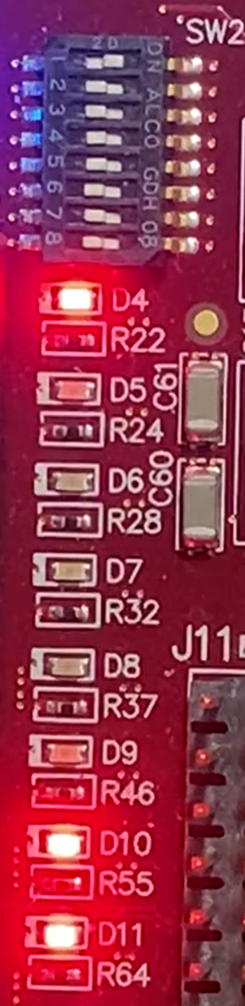
FIFO/FPGA Pin Connections
read_enable
write_enable
reset
8 input switches
Same clock for reader and writer
FIFO Depth = 4 = b’100
Data input and output width = 2
Data input is constant = b’11
empty
half_full
full
Counter[2:0]
8 output LEDs
data_out[1:0]

Slide 4
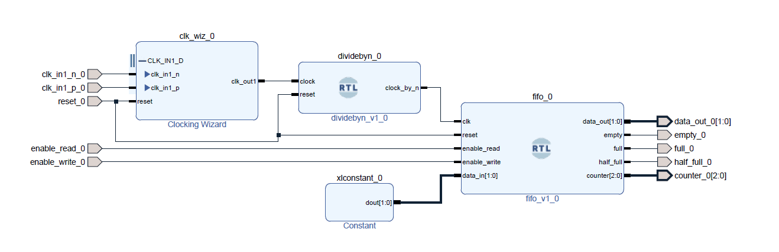
Block Diagram
Clock wizard converts 200 MHz differential clock to a single-ended 10 MHz clock
Clock divider converts 10 MHz clock to 1 Hz clock for the FIFO
All other ports are external and are connected to FPGA pins in the constraint file

Slide 5
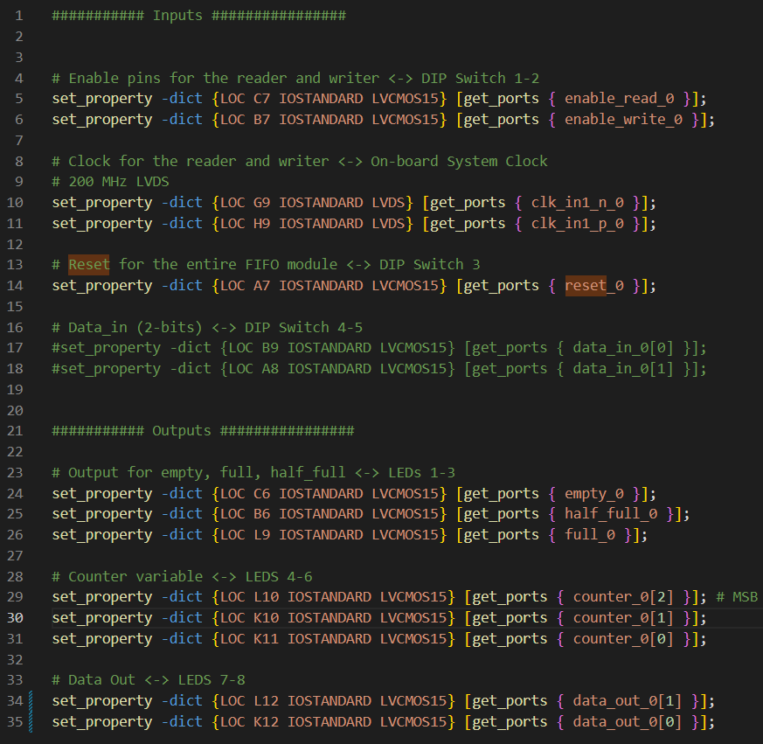
Constraint File

Slide 6
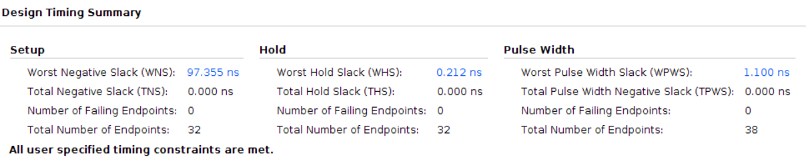
Timing Report

Slide 7
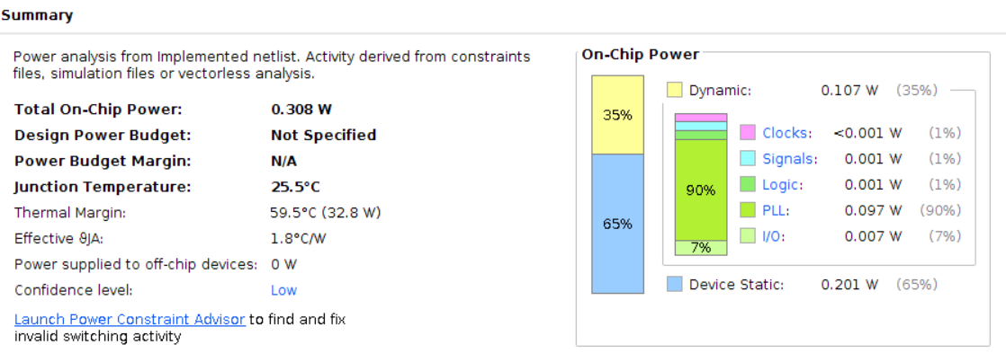
Power Report

Slide 8
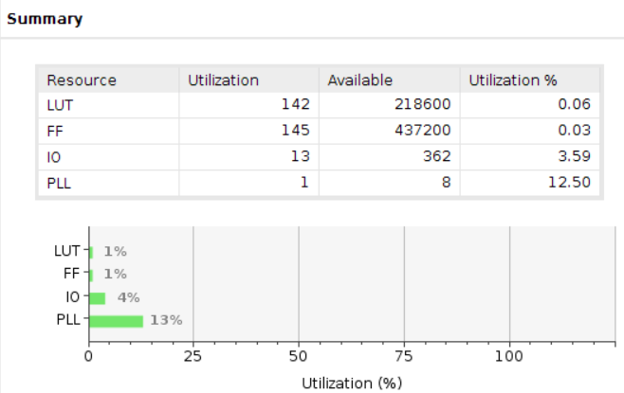
Utilization Report

Slide 9
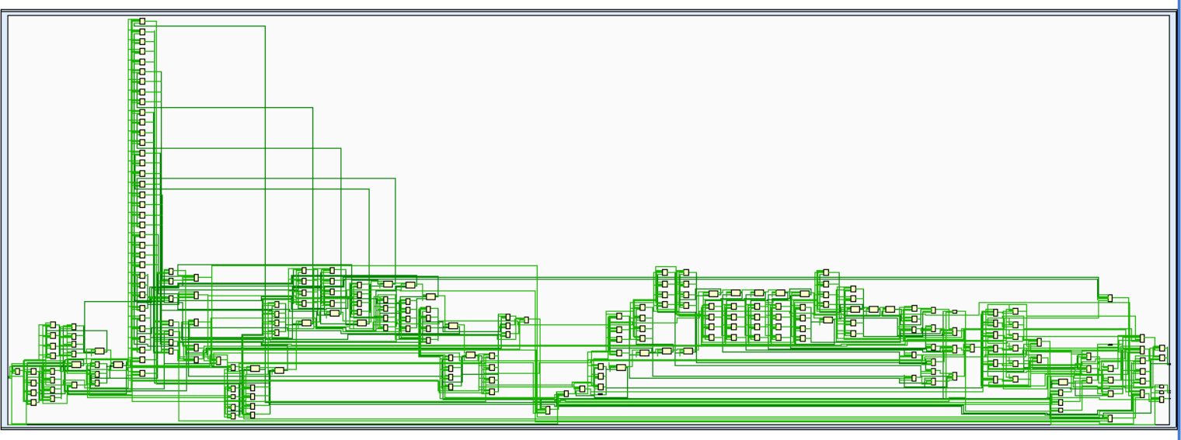
Schematic

Slide 10
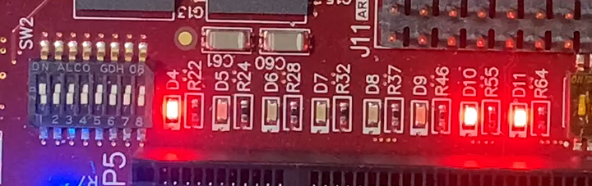
Demo

Slide 11
Thank You Questions/Comments?

